Slide 1
Mini Project 1: Alternative Fuel Locations
DS-450: Team Pineapple
Samia M, Sal P, Nik M

Slide 2


Intro
Data obtained from the 21st Century Environmental Policy
Analysis of alternative fuel locations for the following fuel types:
Compressed Natural Gas (CNG)
Ethanol (E85)
Propane/Liquefied Petroleum Gas (LPG)
Biodiesel (B20 and above)
Electric Vehicle Charging (ELEC)
Hydrogen (HY)
Liquefied Natural Gas (LNG)

Slide 3


Methodology
Analyzed data for:
United States overall
Specific regions of the United States
Top 10 most populous states
Electric vehicle fuel stations
Tableau software used to create data visualizations

Slide 4
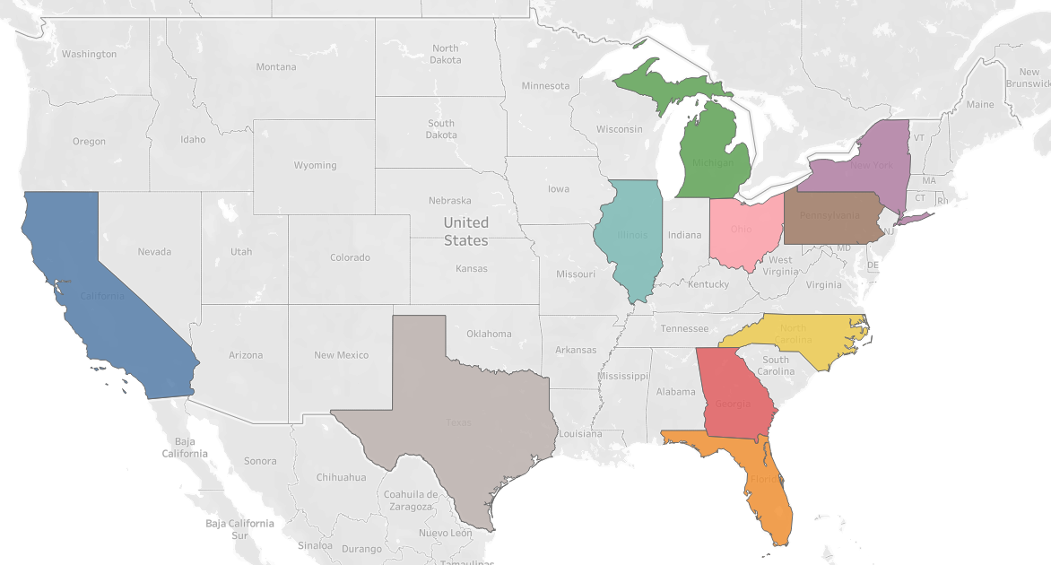
Methodology
Top 10 Most Populous States as of 2023:
California
Texas
Florida
New York
Pennsylvania
Illinois
Ohio
Georgia
North Carolina
Michigan

Slide 5
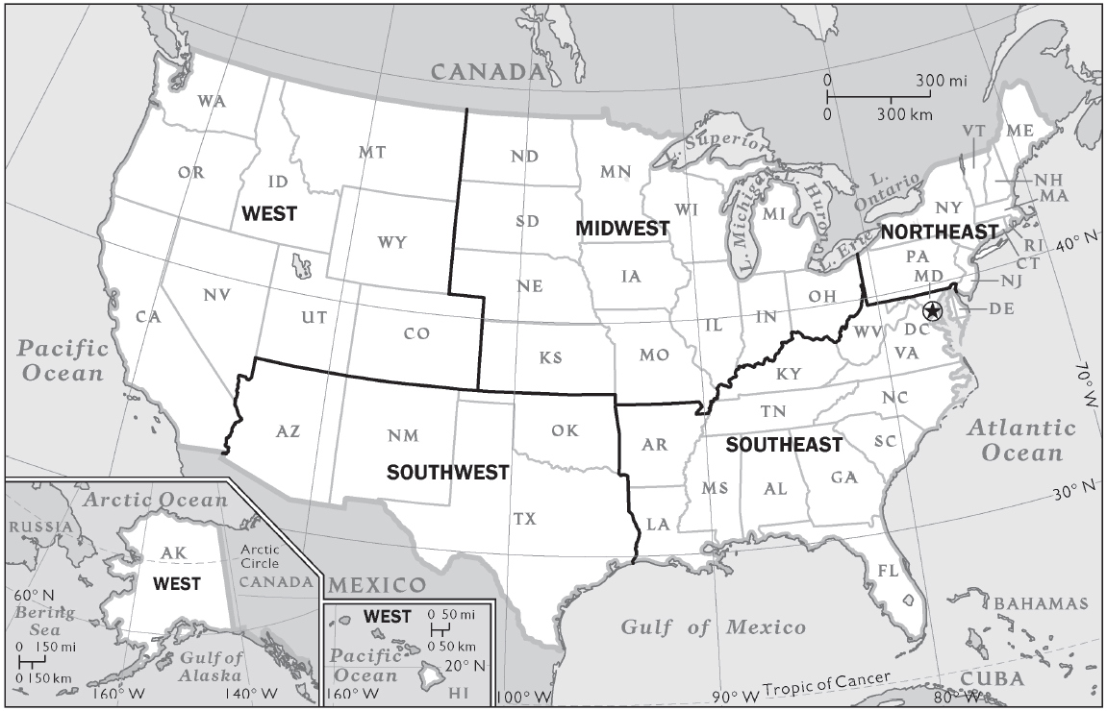
Methodology
U.S. geographic regions:
West: Washington, Montana, Idaho, California, Nevada, Utah, Colorado, Wyoming
Southwest: Alaska, Hawaii, Arizona, New Mexico, Texas, Oklahoma
Midwest: North Dakota, South Dakota, Minnesota, Nebraska, Kansas, Iowa, Wisconsin, Illinois, Indiana, Ohio, Michigan
Northeast: New Jersey, Pennsylvania, New York, Connecticut, Rhode Island, Massachusetts, New Hampshire, Maine, Vermont
Southeast: Arkansas, Alabama, Mississippi, Tennessee, Kentucky, Florida, Georgia, South Carolina, North Carolina, Virginia, West Virginia, Maryland, Delaware
Washington DC, and Puerto Rico were also included in the Southeast region

Slide 6
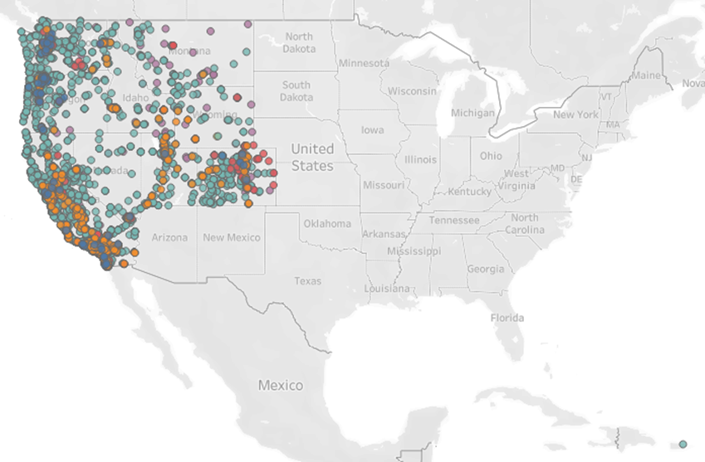
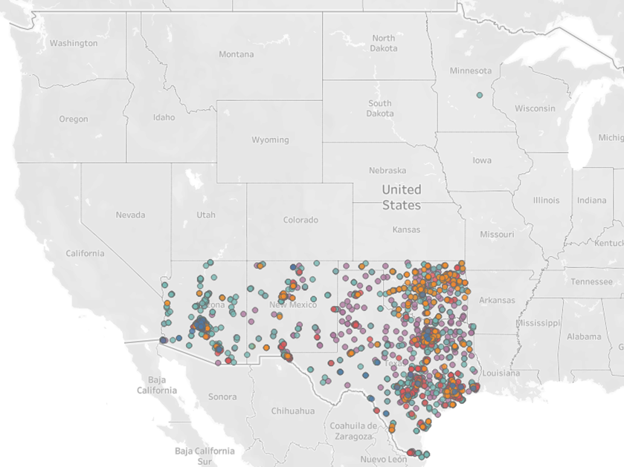
Data Cleaning and Preprocessing
Correcting alternative fuel locations based on
State abbreviation
Longitude and Latitude coordinates

Slide 7
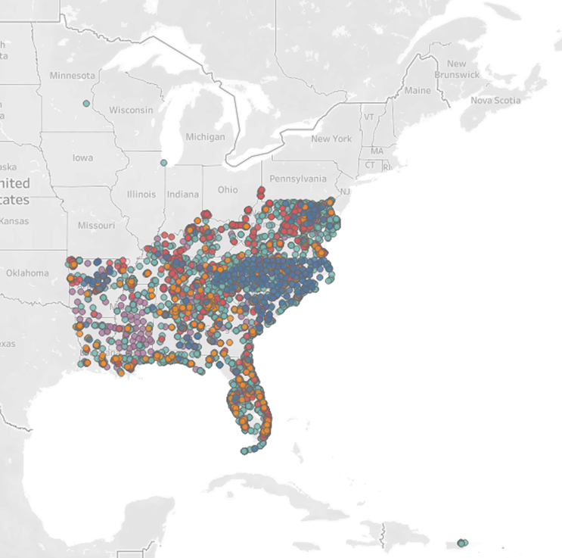
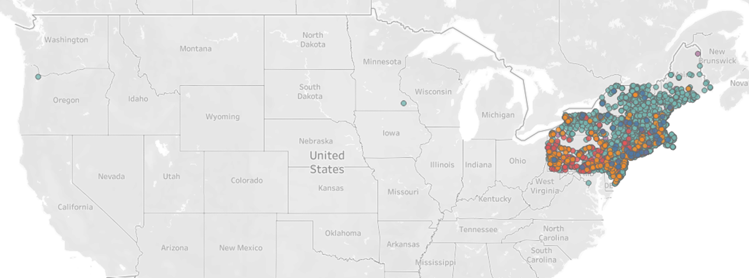
Data Cleaning and Preprocessing
Correcting alternative fuel locations based on
State abbreviation
Longitude and Latitude coordinates

Slide 8

United States Data Visualizations
z

Slide 9

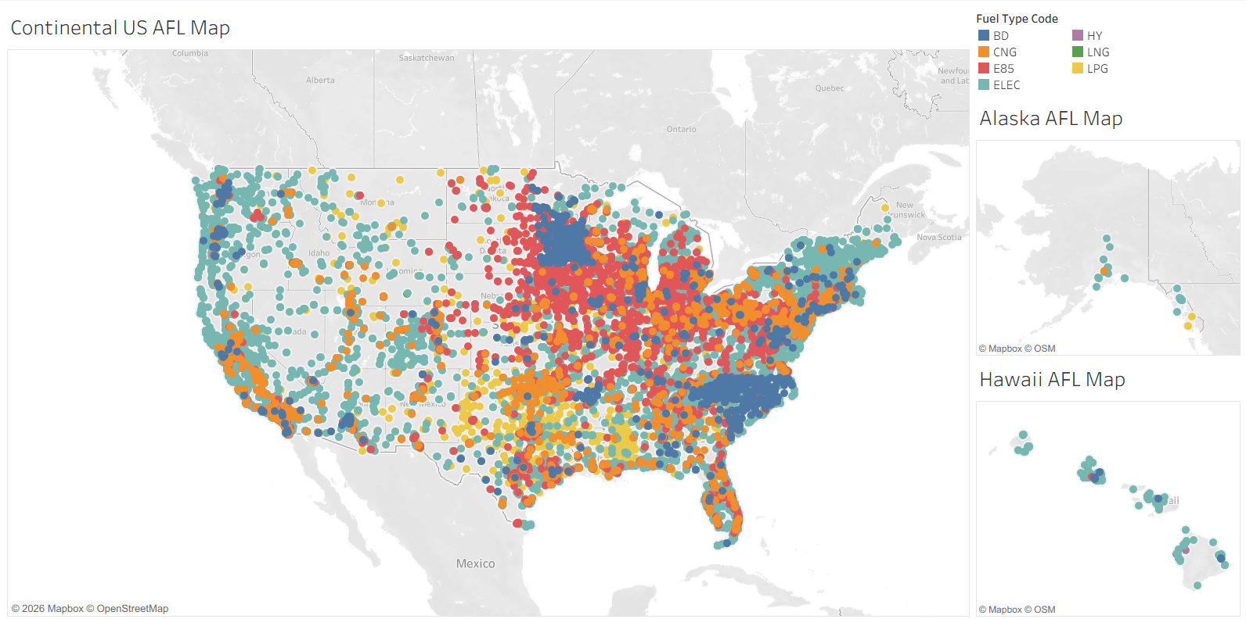

Slide 10
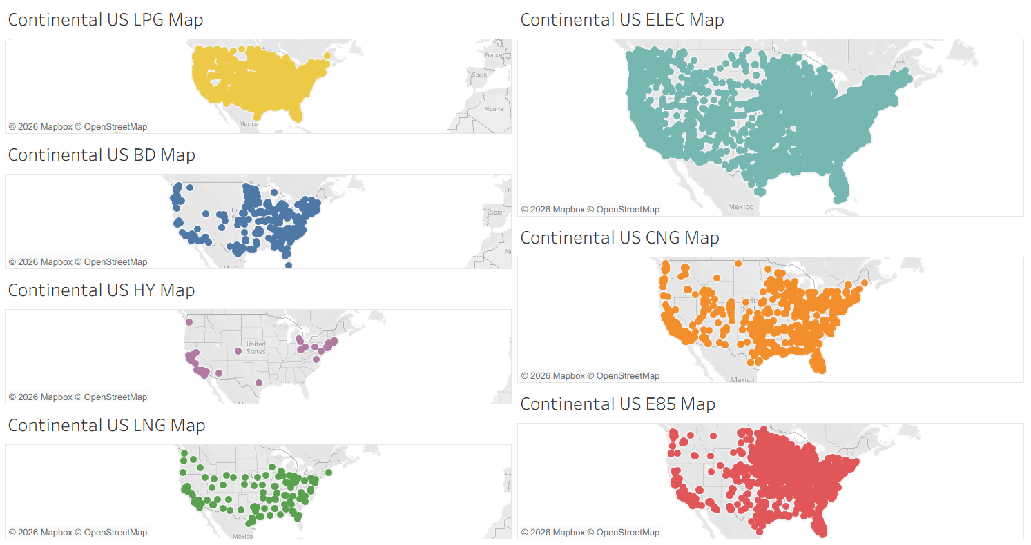

Slide 11
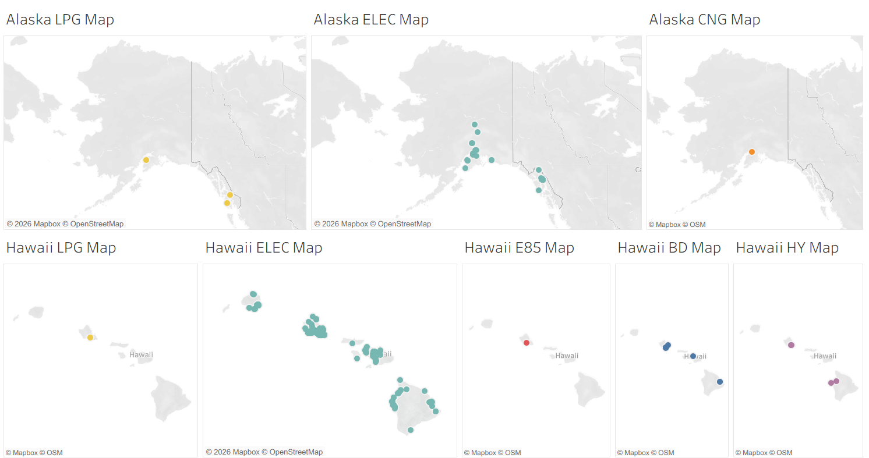

Slide 12
Regions Data Visualizations
z

Slide 13
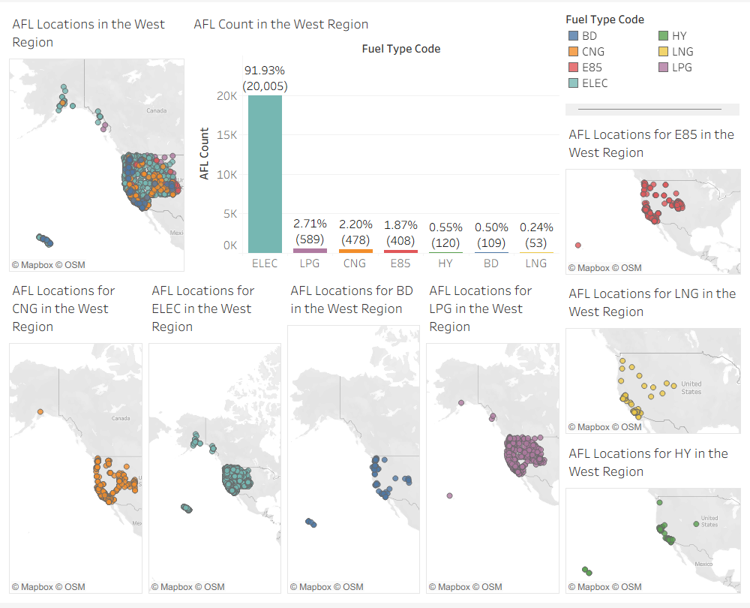
West Region
z

Slide 14
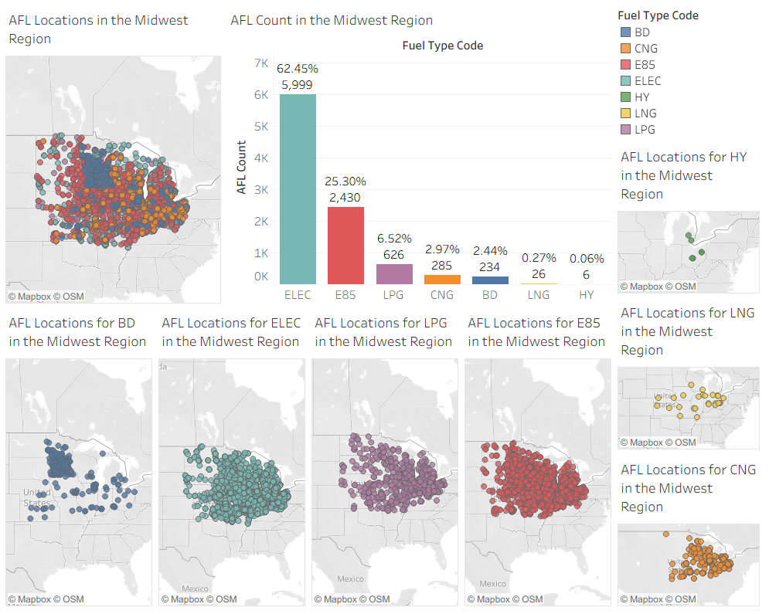
Midwest Region
z

Slide 15
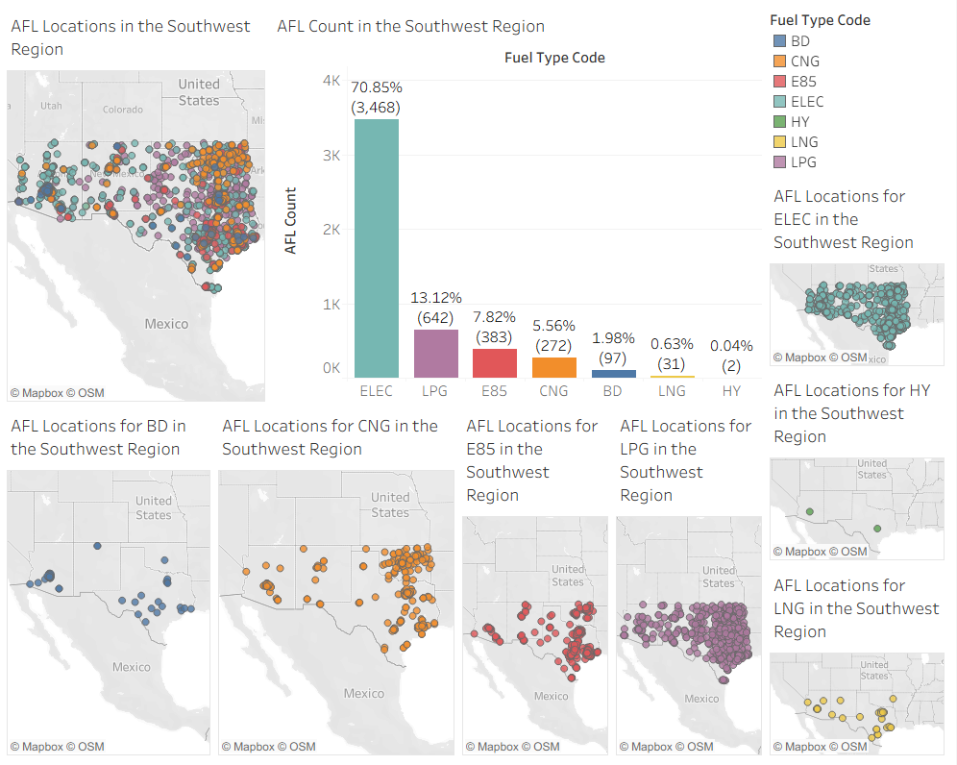
Southwest Region
z

Slide 16
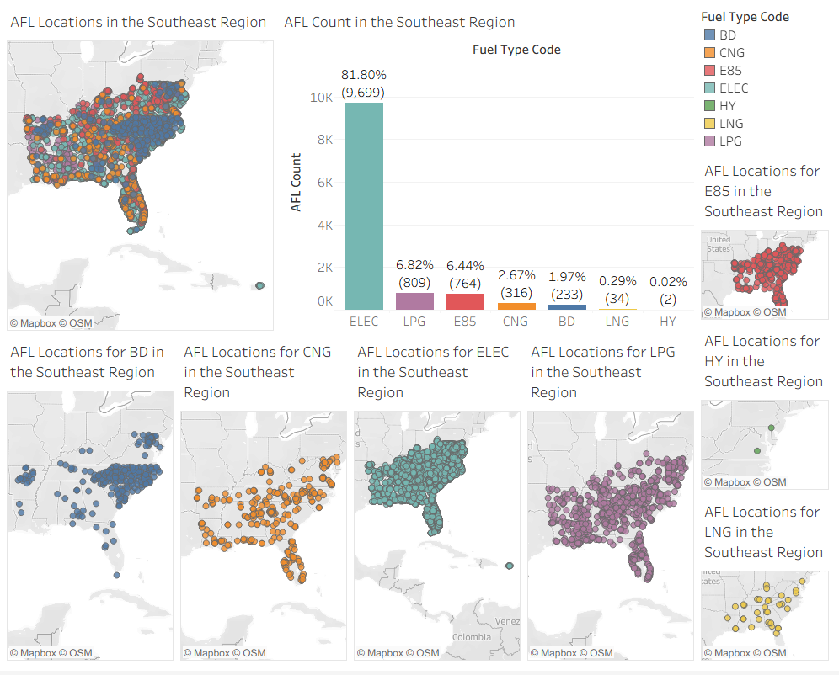
Southeast Region
z

Slide 17
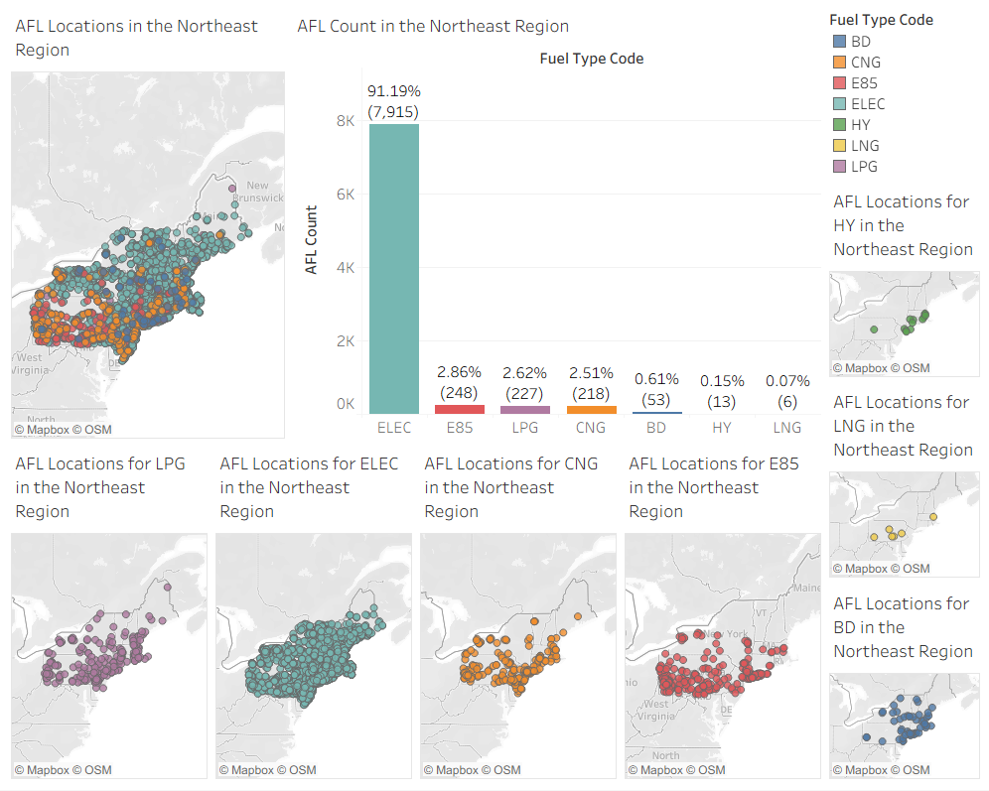
Northeast Region
z

Slide 18
Specific State Data Visualizations
z

Slide 19
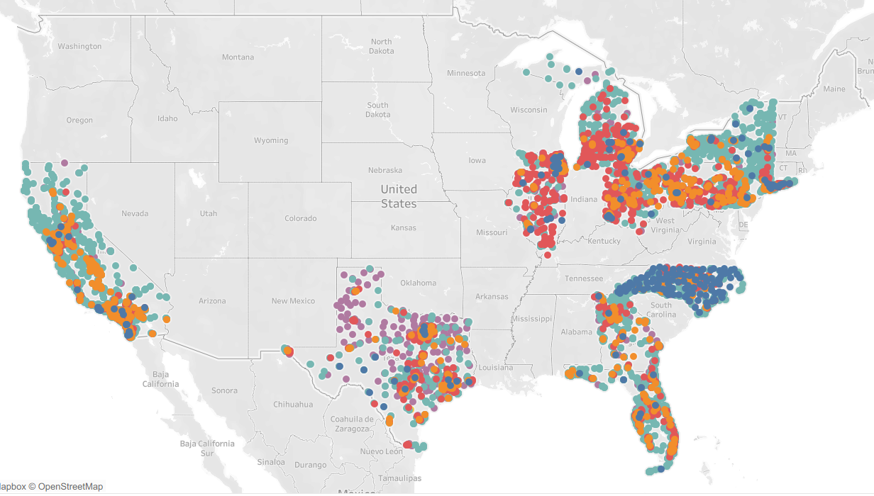
Fuel Type for the Top 10 Most Populous States

Slide 20
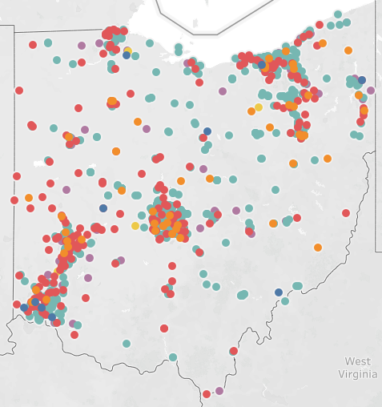
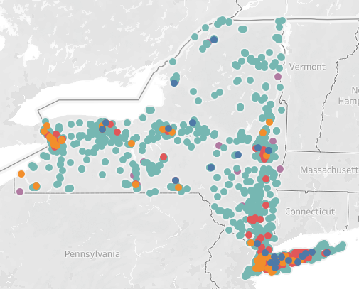
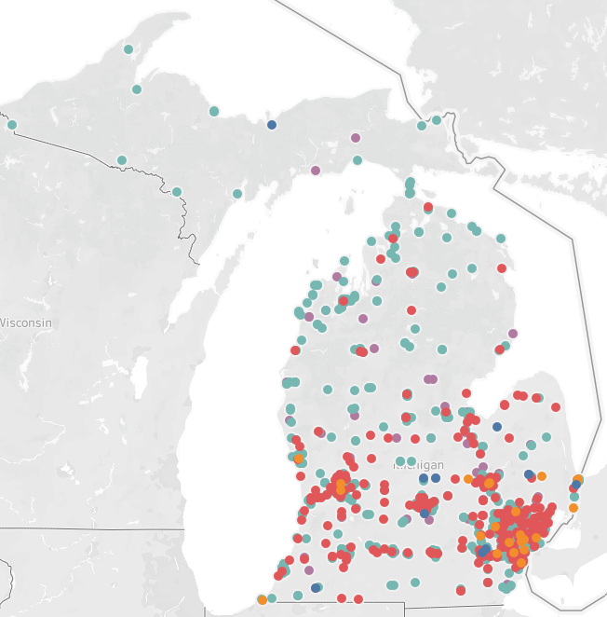
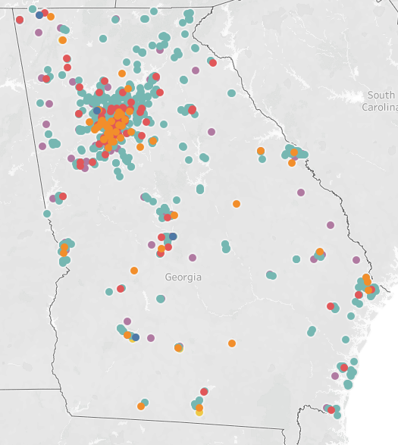
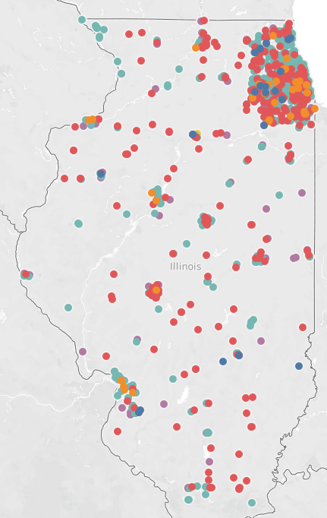
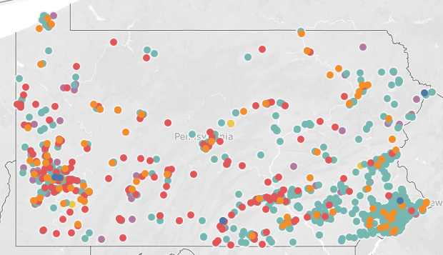
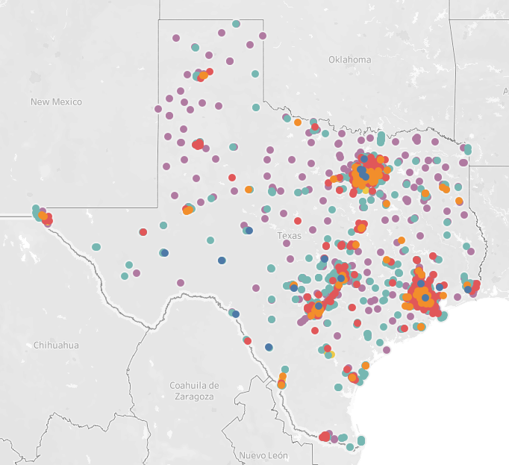
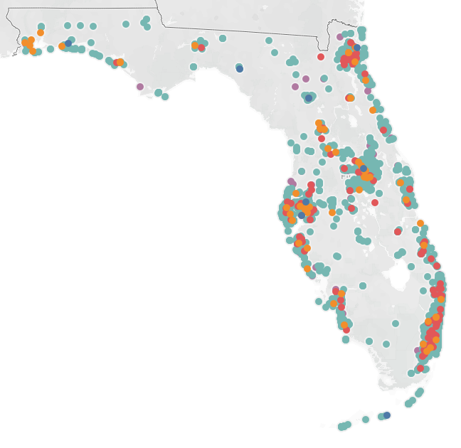
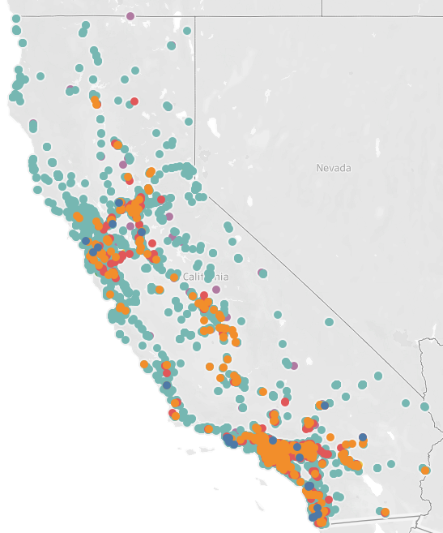
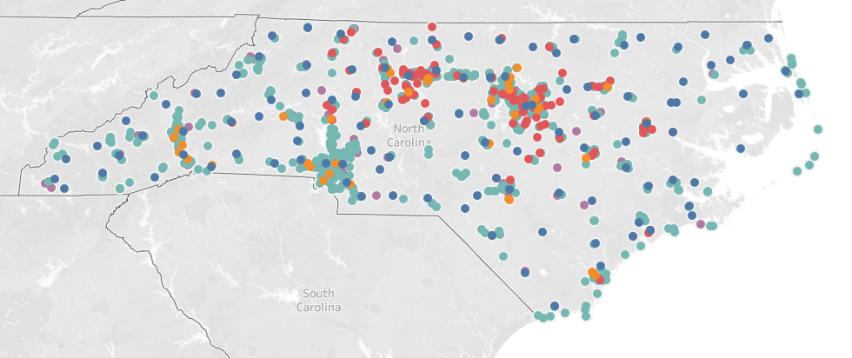
Ohio AFL Map
New York AFL Map
Michigan AFL Map
Georgia AFL Map
Illinois AFL Map
Pennsylvania AFL Map
Texas AFL Map
Florida AFL Map
California AFL Map
North Carolina AFL Map

Slide 21
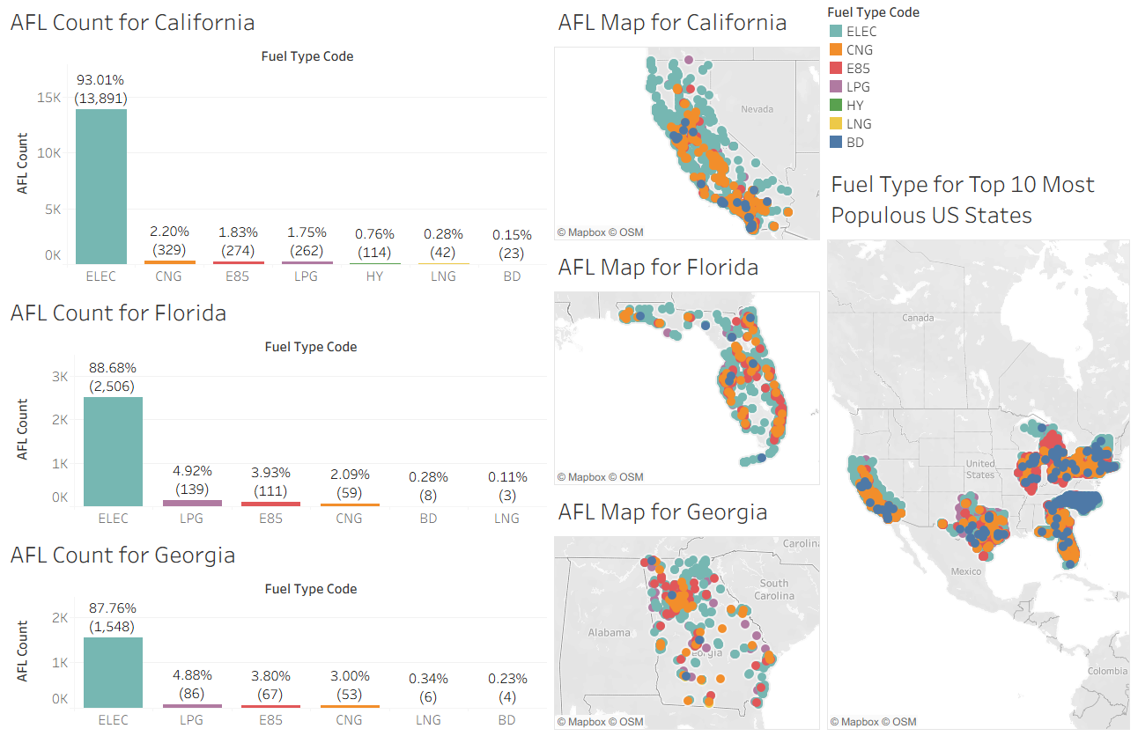
z

Slide 22
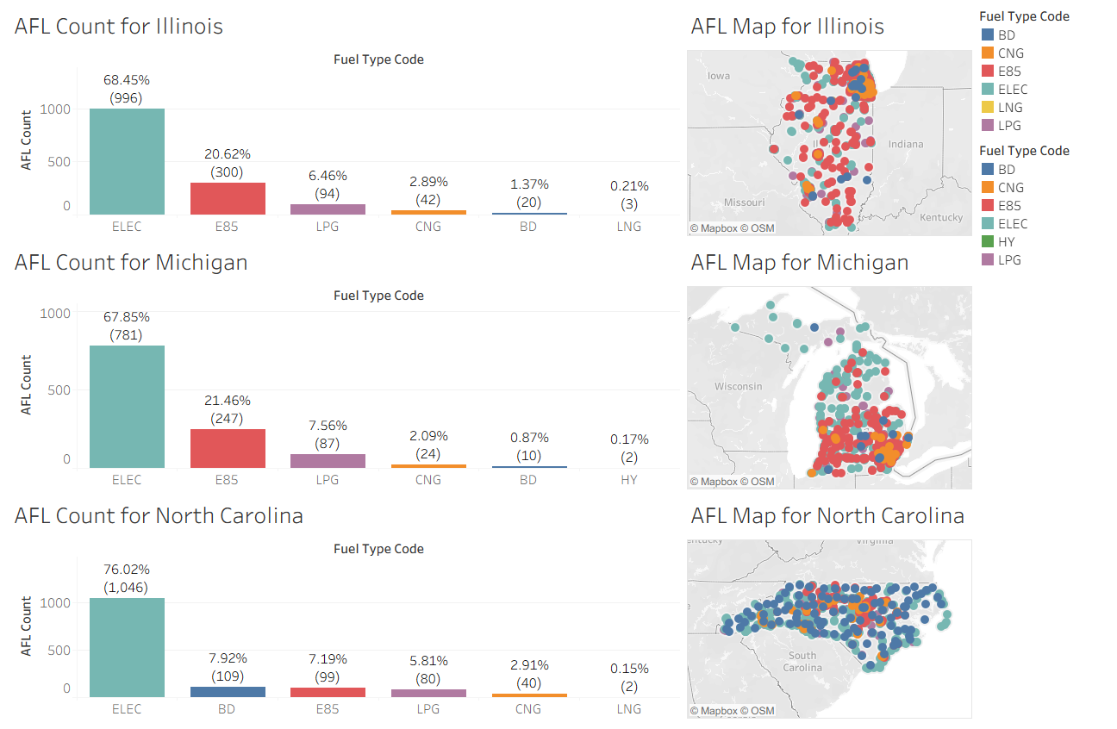
z

Slide 23
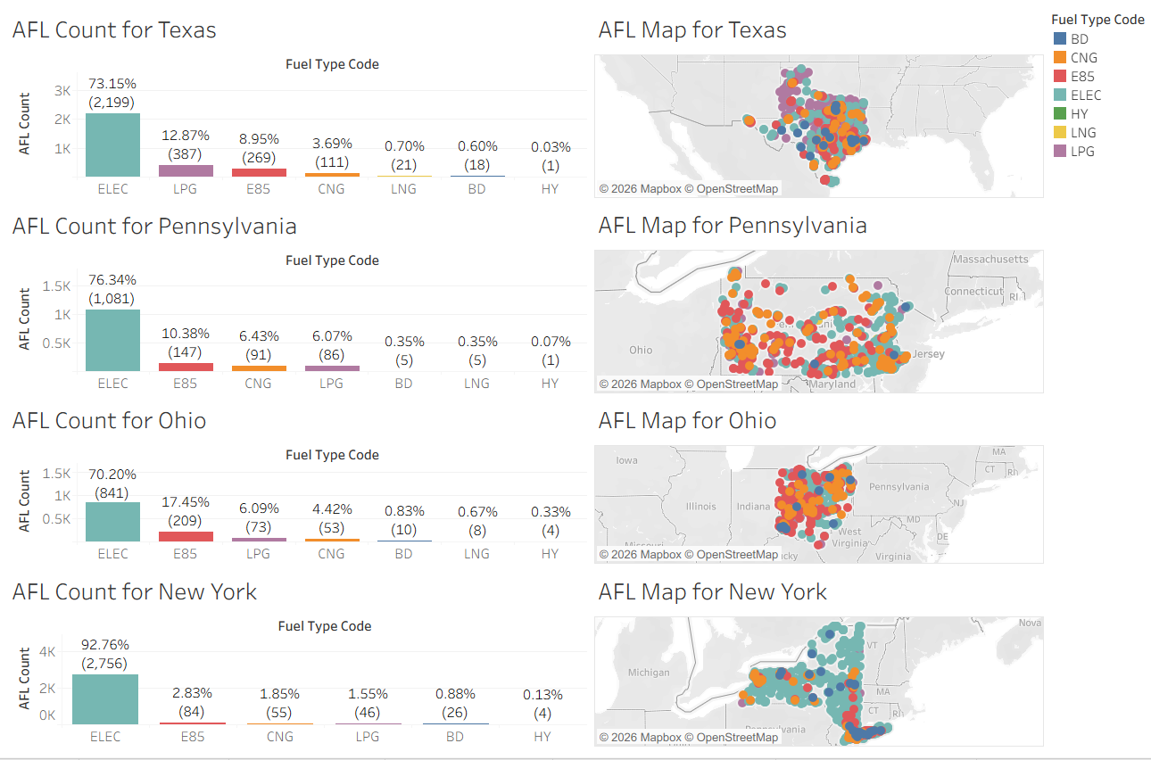
z

Slide 24
Electric Vehicle Data Visualizations
z

Slide 25
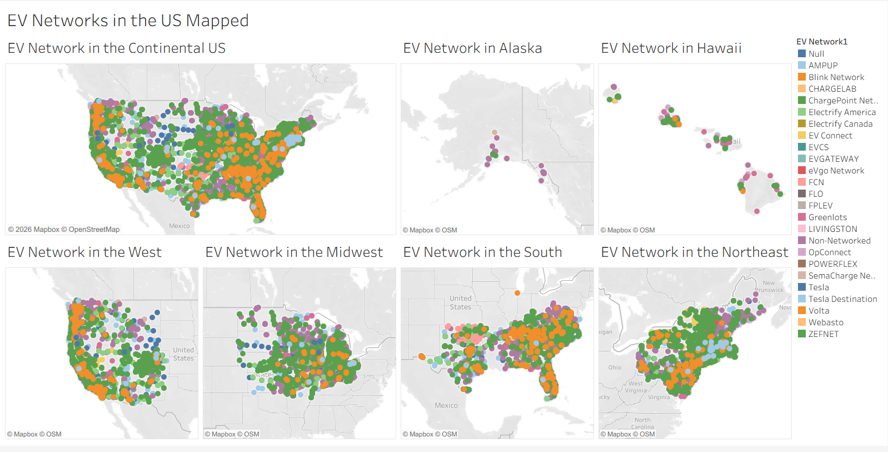
z

Slide 26
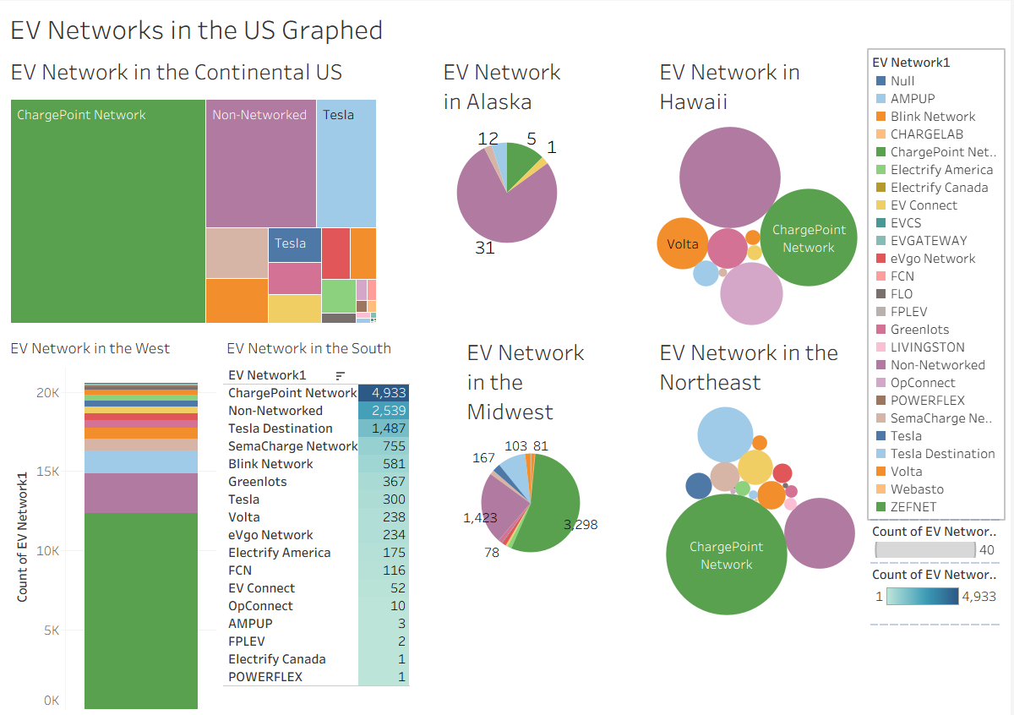

Slide 27
In Conclusion
Electric fuel is the most prominent alternative by location quantity
Other fuel types lag behind nationally, but present in regional hotspots
The use of Tableau displayed the variety and concentration of alternative fuel in the U.S.

